Slide 1

Deep Insights into the Drift Diffusion Model: From Basics to Variants
Yong-Ming Tian, Zong-Yi Chen, Shiqi Liu, Yajie Li

Slide 2
01
Introduction
02
Basic DDM Experiment
CONTENT
03
Variants of DDM Experiment
04
Extensions of DDM and Deeper Insight
05
Conclusion

Slide 3
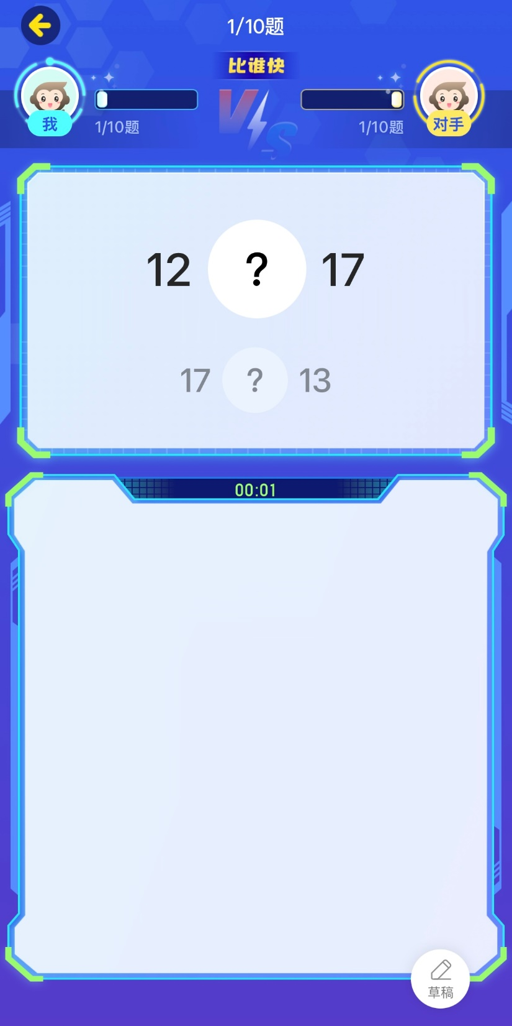
https://www.ypppt.com/
Introduction
topic
The craze of Xiao Yuan Kousuan
A simple process of decision
Accuracy and reaction time
Study humans’ decision processes

Slide 4
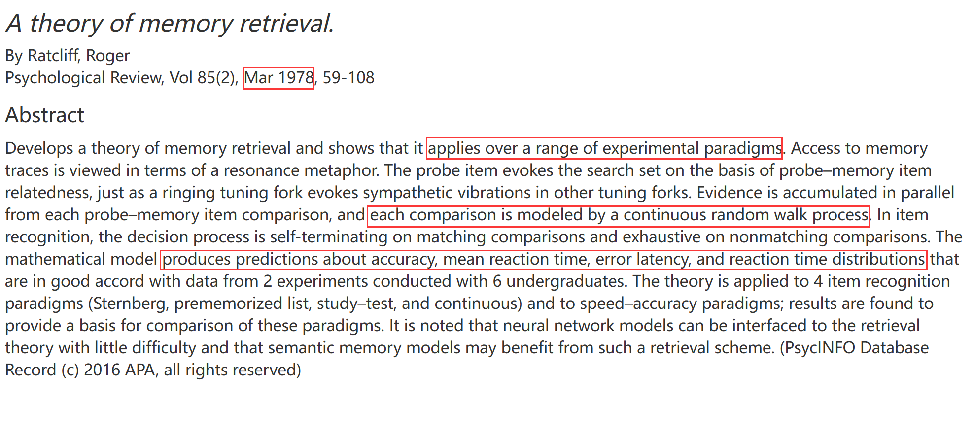
https://www.ypppt.com/
Drift Diffusion Model
Parameters:
drift rate
boundary size
noise
non-decision times
starting point
……
Measures:
accuracy
response times
probabilities of making choices
……
[1]Ratcliff, R. (1978). A theory of memory retrieval. Psychological Review, 85(2), 59-108. https://doi.org/10.1037/0033-295X.85.2.59

Slide 5
01
Introduction
02
Basic DDM Experiment
CONTENT
03
Variants of DDM Experiment
04
Extensions of DDM and Deeper Insight
05
Conclusion

Slide 6
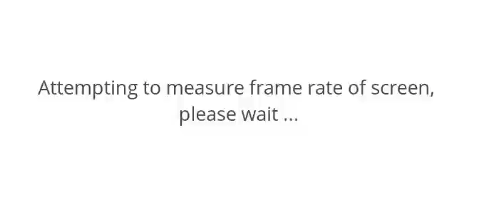
https://www.ypppt.com/
Basic DDM Experiment
Settings
A simple but robust size-comparison task
Gaze on the center cross “×”
Press the corresponding key to indicate the larger circle
Prioritize accuracy, then as quickly as possible
r = (size_right / size_left) – 1 (“coherence”in random dots motion[2])
r ∈ [-0.32, -0.24, -0.16, -0.08, 0, 0.08, 0.16, 0.24, 0.32]
Data sufficiency
15 undergraduates from Nanjing University and Tsinghua University
Each completed 160 size-comparison trials, 2400 in total
[2]K. Britten, M. Shadlen, W. Newsome, and J. Movshon, “The analysis of visual motion: a comparison of neuronal and psychophysical performance,” Journal of Neuroscience, vol. 12, no. 12, pp. 4745–4765, 1992.

Slide 7
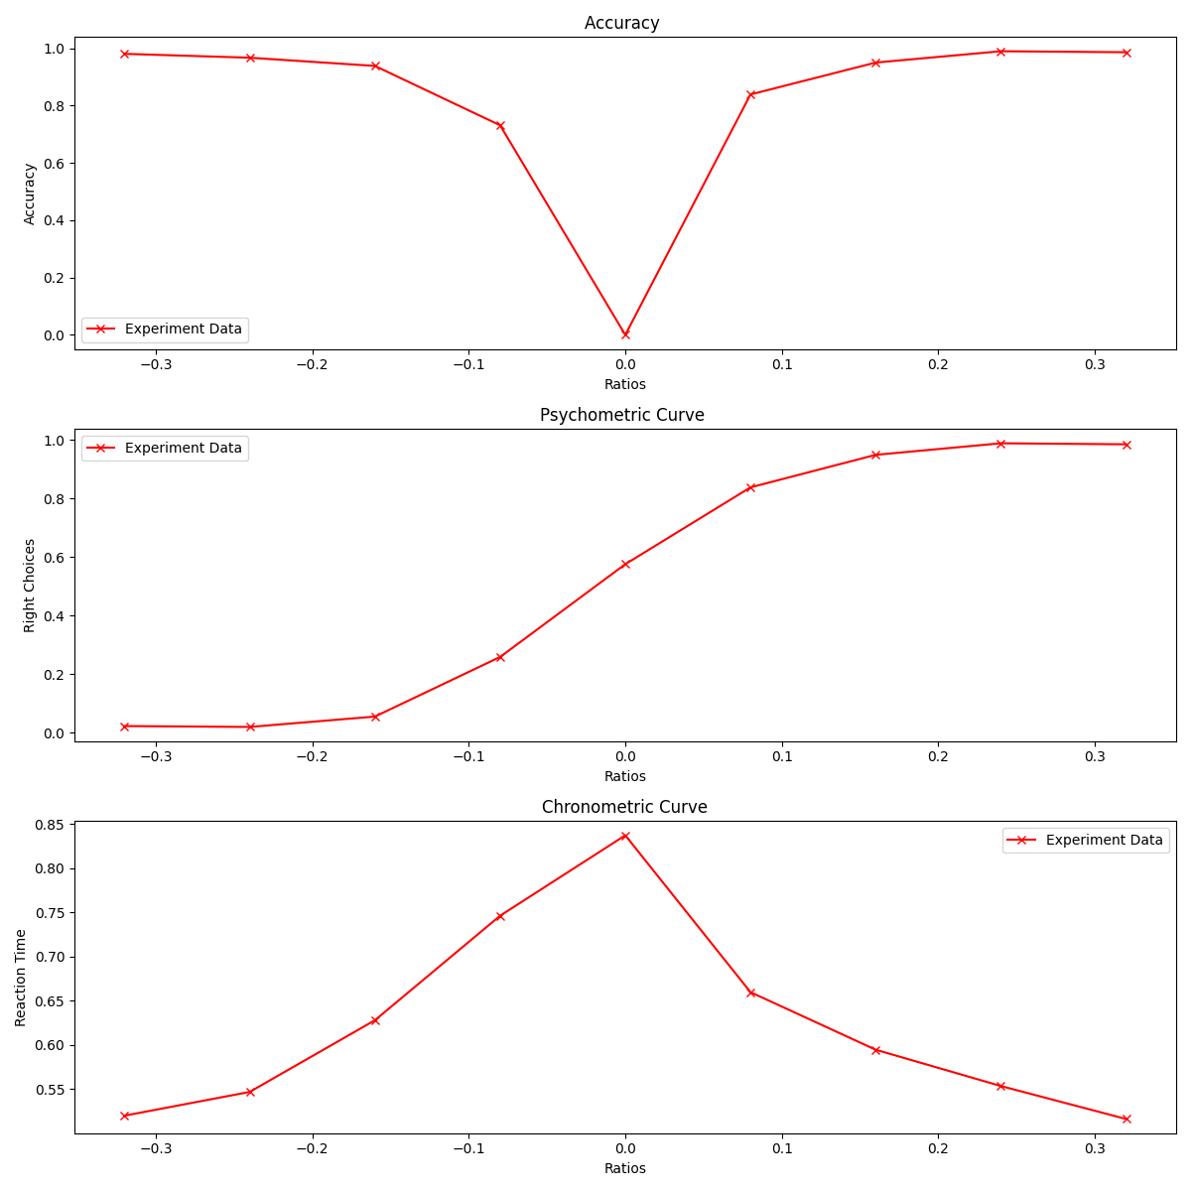
https://www.ypppt.com/
Experimental Results

Slide 8
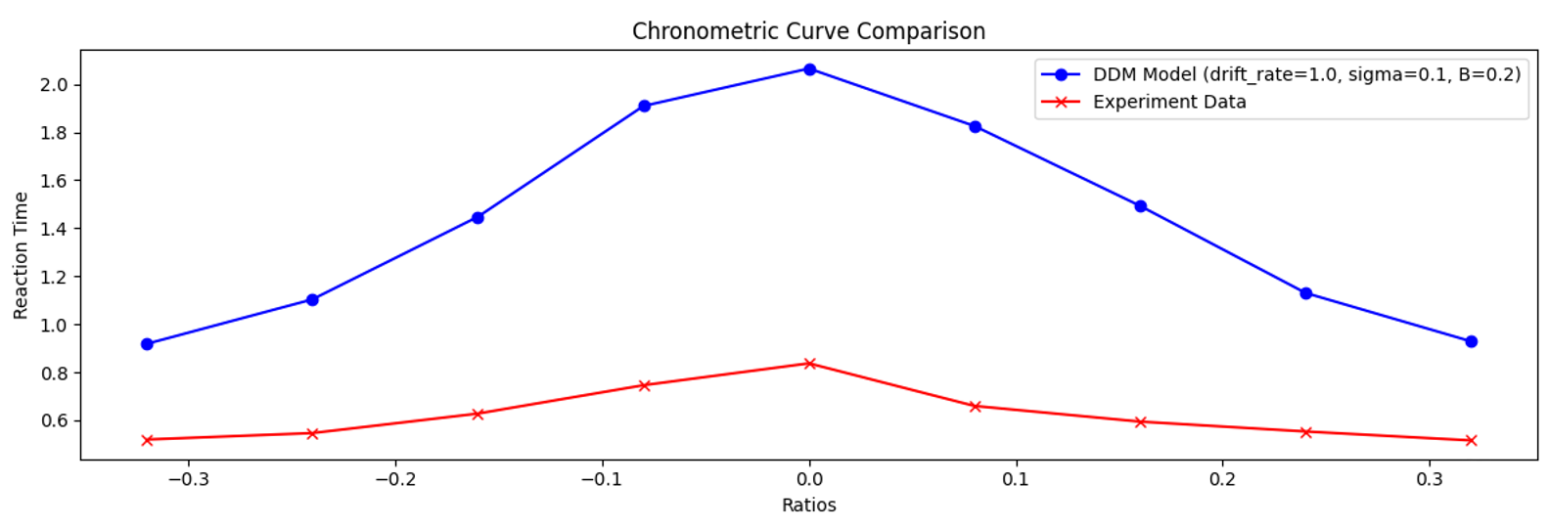
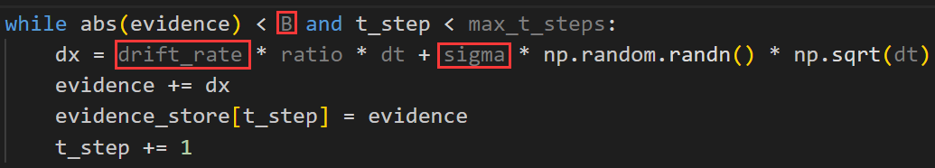
https://www.ypppt.com/
Use DDM to Fit the Results
The effect is poor at first !
Reasons:
Relatively easy experiment
A slightly higher drift rate
Smaller bounds
……
➡ Parameter Search
Goal: minimize the MSE of the RT-r plot
Three parameters have a linear relationship?
Use grid search for three parameters

Slide 9
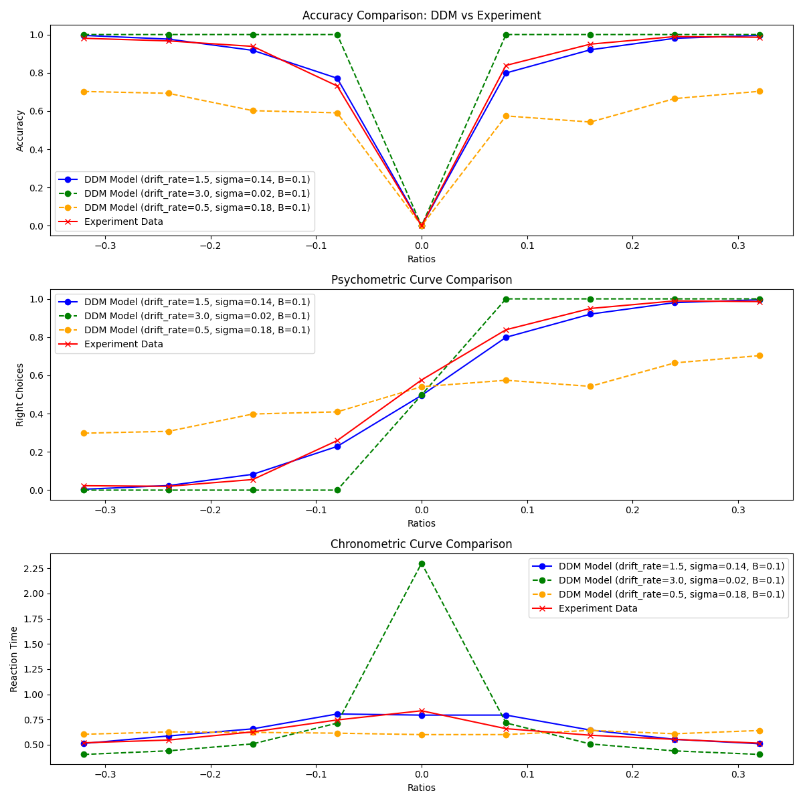
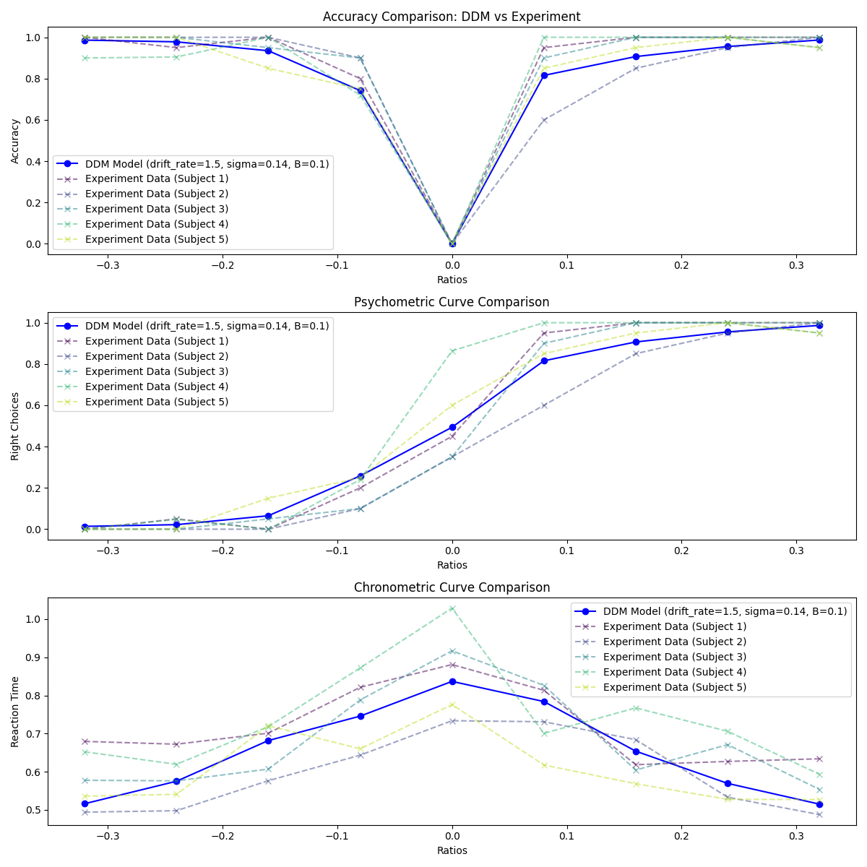
https://www.ypppt.com/
Basic DDM Experiment Results

Slide 10
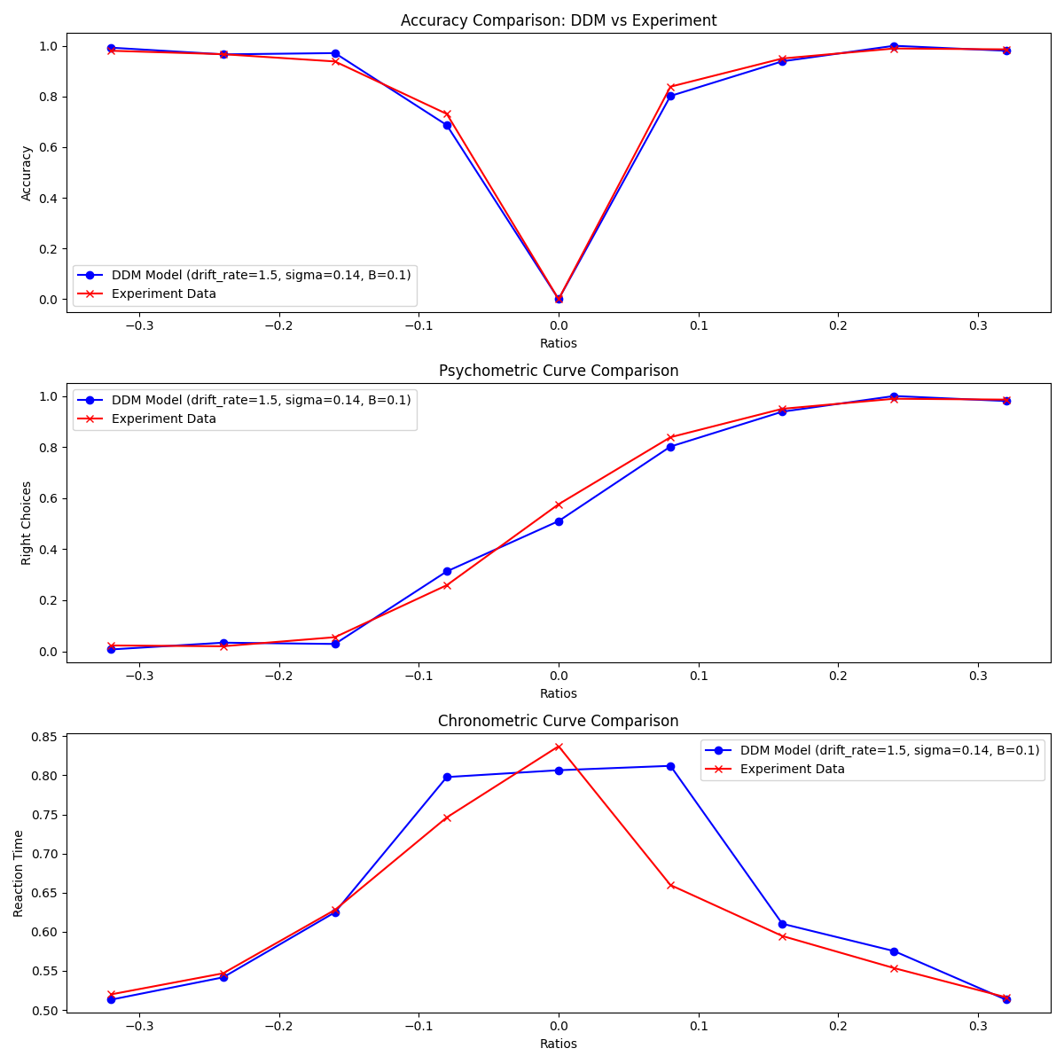
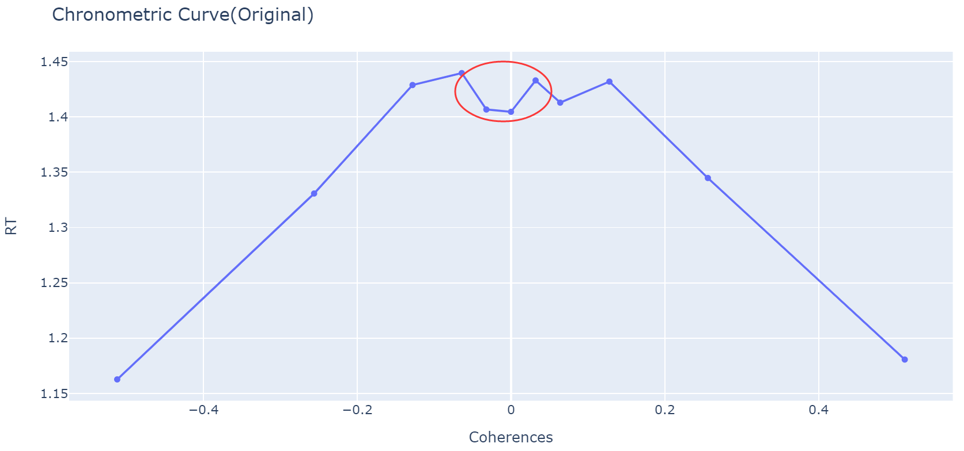
https://www.ypppt.com/
Basic DDM Experiment - The Best Fit
A dent in the middle
Improvement of Experiment：
Reduce space between circles
Discard circles that are too small
Set the keys to F and J
Add white board

Slide 11
01
Introduction
02
Basic DDM Experiment
CONTENT
03
Variants of DDM Experiment
04
Extensions of DDM and Deeper Insight
05
Conclusion

Slide 12

https://www.ypppt.com/
Variant I - Time Pressure
Settings
As fast as possible while ensuring a certain level of accuracy.
Collapsing Bound Fitting

Slide 13
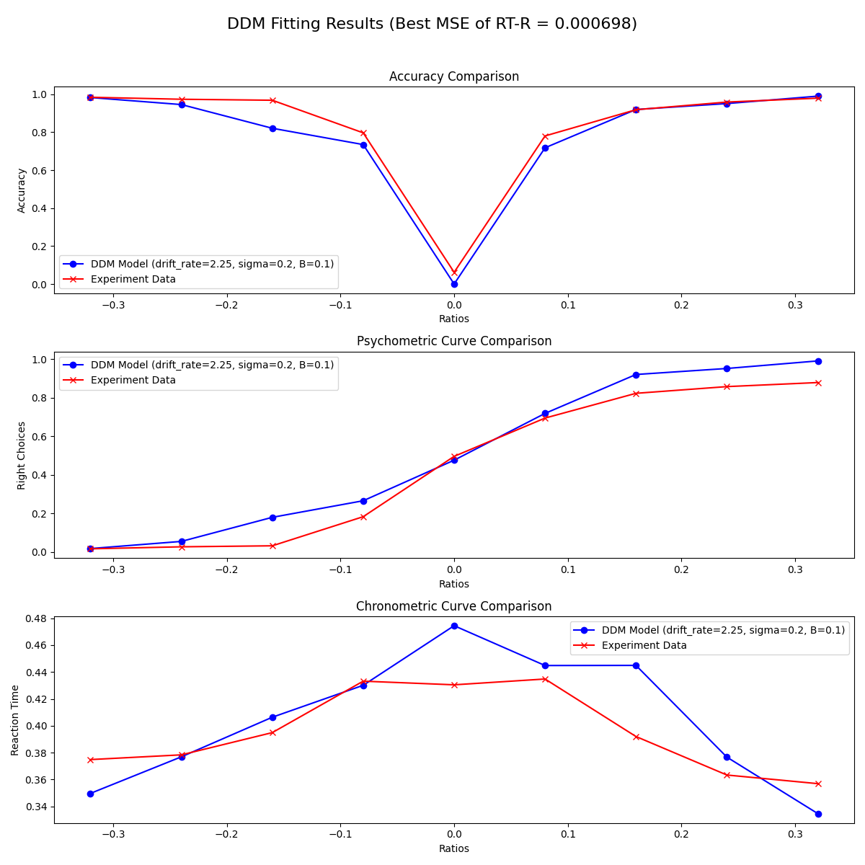
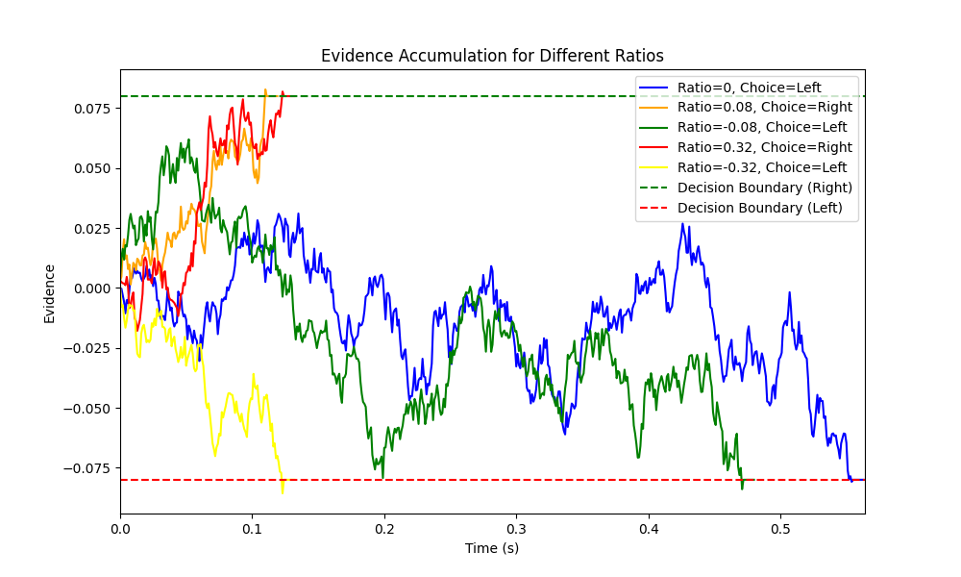
https://www.ypppt.com/
Variant I - Time Pressure
Basic DDM

Slide 14
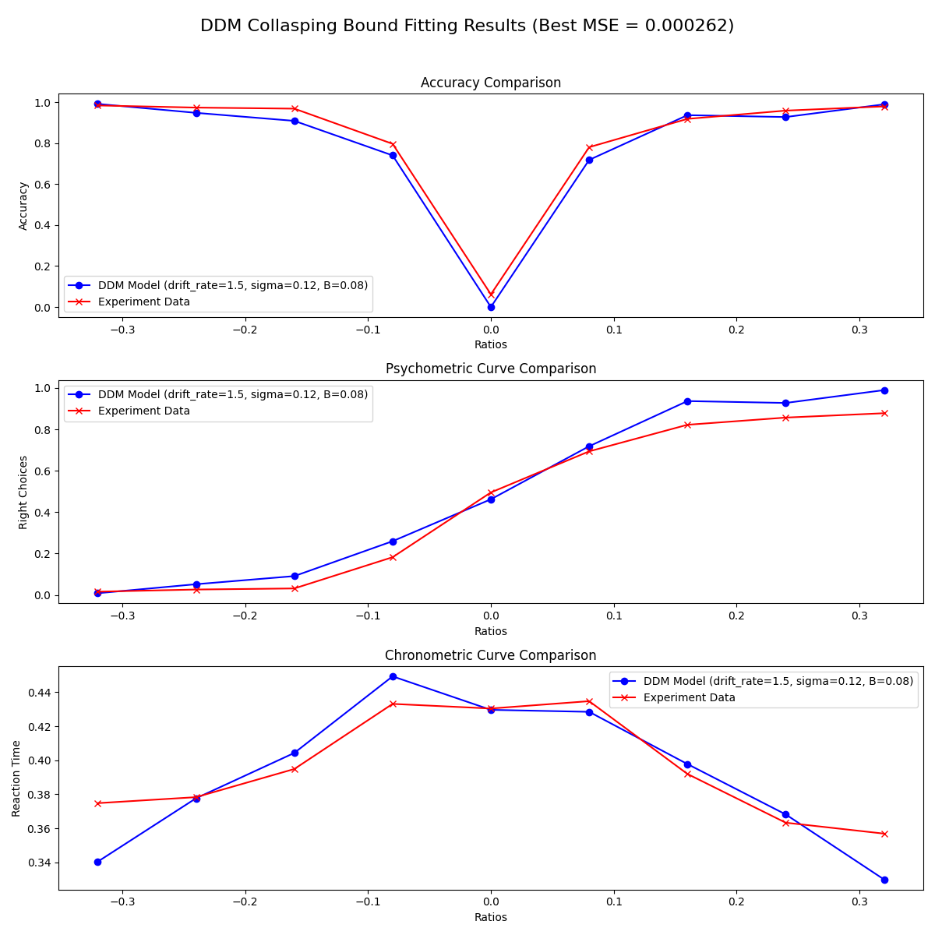
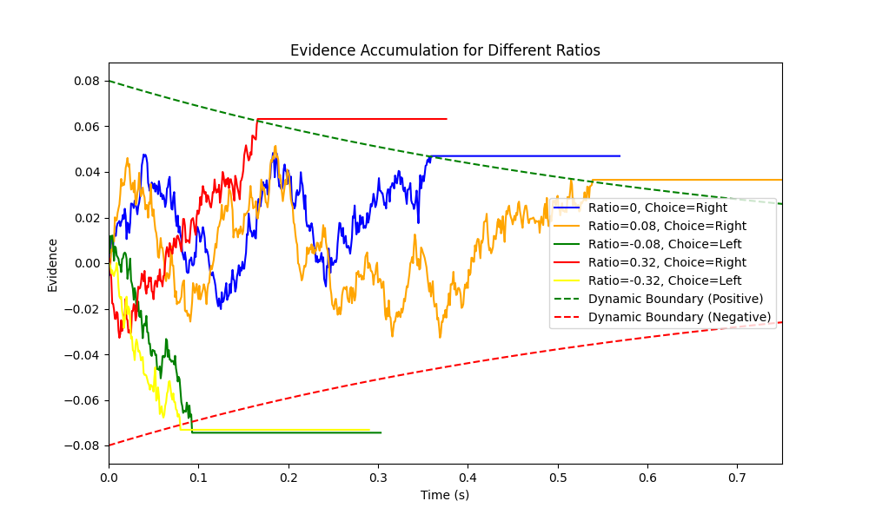
https://www.ypppt.com/
Variant I - Time Pressure
Collapsing Bound DDM

Slide 15

https://www.ypppt.com/
Variant II - Asymmetrical Priors
In basic experiment: always symmetrical results
Human decision-making is asymmetrical in reality
• Teacher’s advise
• Asymmetric priors
• Film language
……
➡ Asymmetrical Priors in humans’ decision
Settings
75% left is bigger / right is bigger

Slide 16
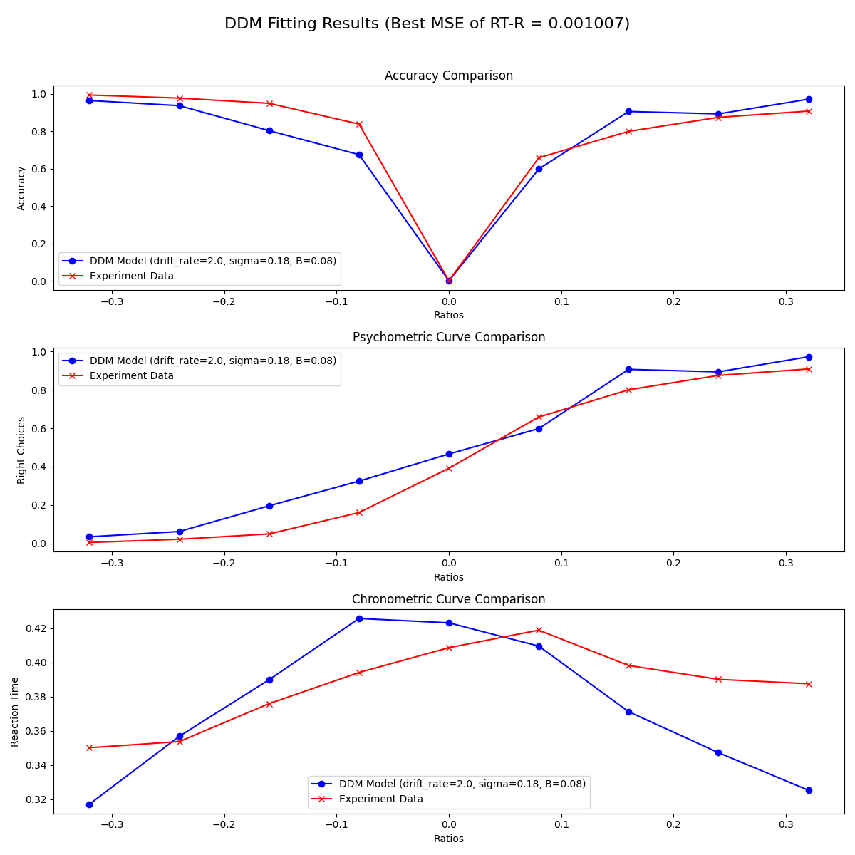
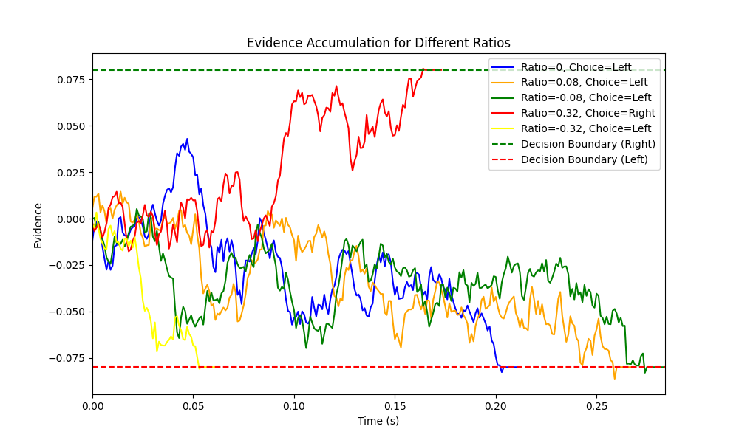
https://www.ypppt.com/
Variant II - Asymmetrical Priors
Without Bias（75% left is bigger）

Slide 17
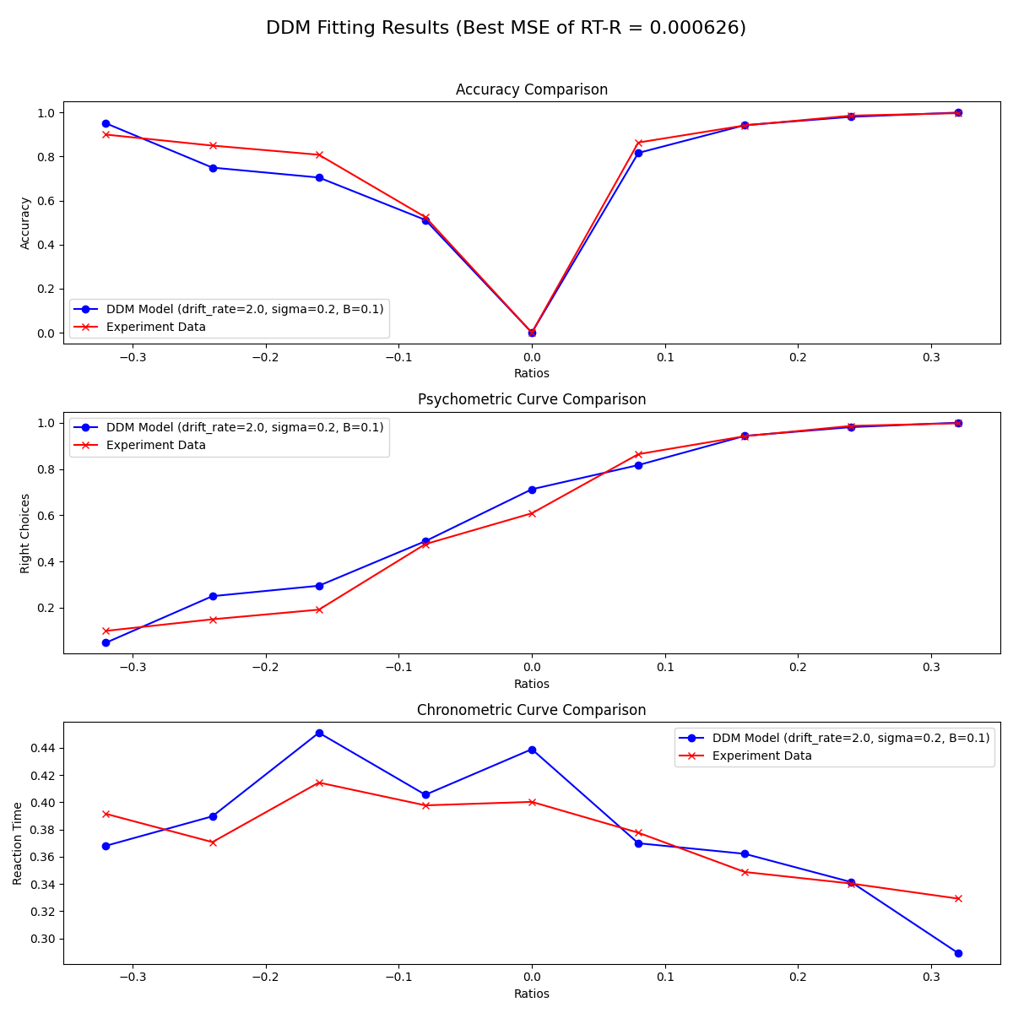

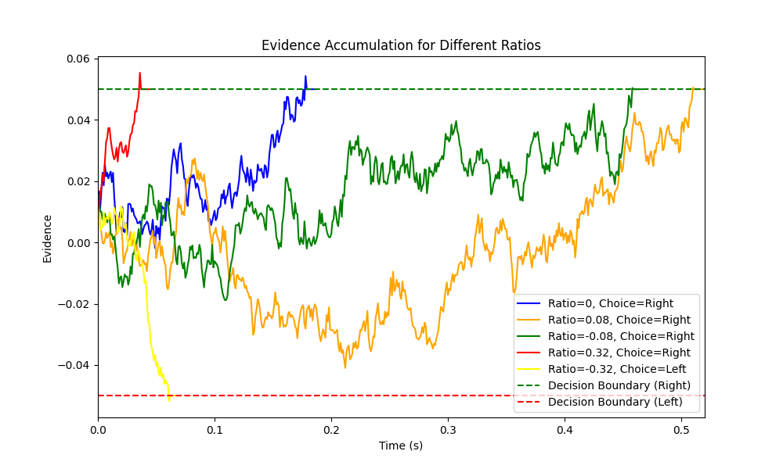
https://www.ypppt.com/
Variant II - Asymmetrical Priors
With Bias （75% right is bigger）
[3]R. Ratcliff and G. McKoon, “The Diffusion Decision Model: Theory and Data for Two-Choice Decision Tasks,” Neural Computation, vol. 20, pp. 873–922, Apr. 2008.

Slide 18
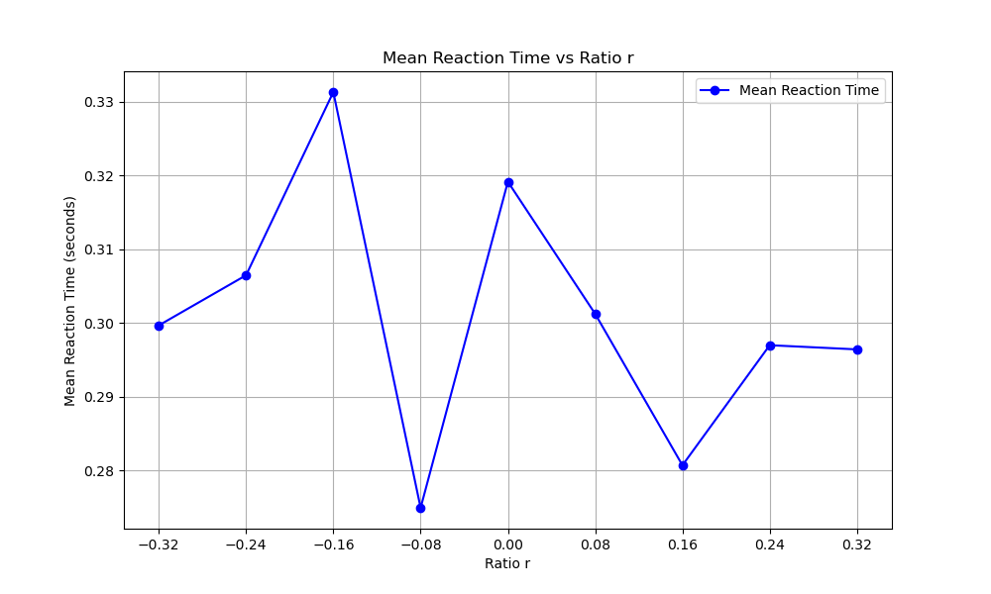
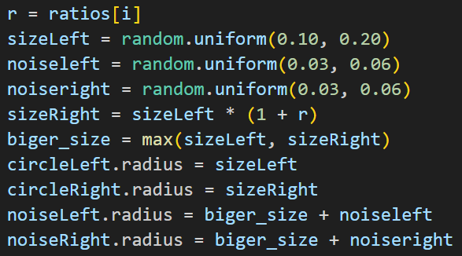

https://www.ypppt.com/
Variant III – Adding Noise
We once got a totally weird data in Variant II.
Why?
➡ Noise

Slide 19
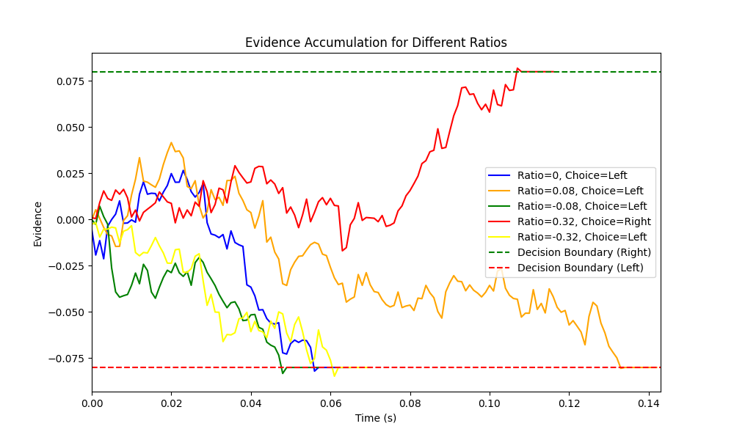
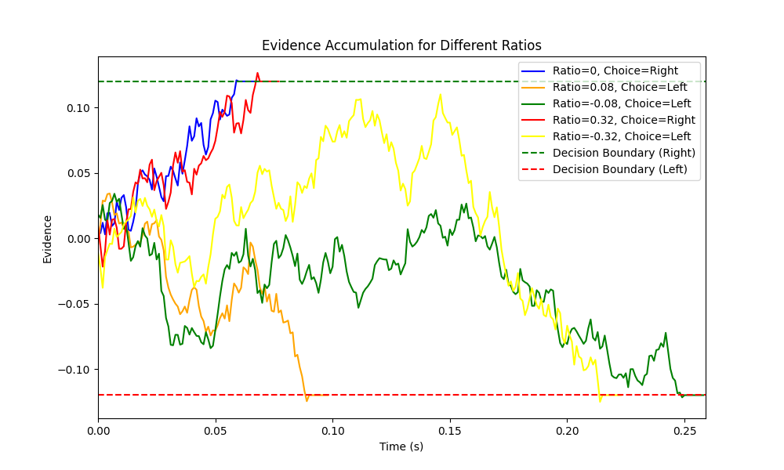
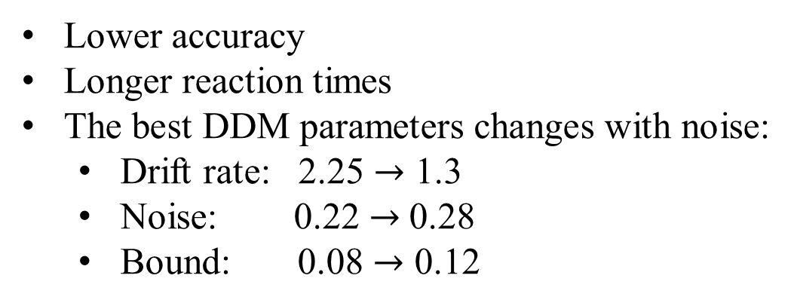
https://www.ypppt.com/
Variant III – Adding Noise
Lower accuracy
Longer reaction times
The best DDM parameters changes with noise:
Drift rate: 2.25 $→$ 1.3
Noise: 0.22 $→$0.28
Bound: 0.08 $→$ 0.12
Without noise
With noise

Slide 20
01
Introduction
02
Basic DDM Experiment
CONTENT
03
Variants of DDM Experiment
04
Extensions of DDM and Deeper Insight
05
Conclusion

Slide 21
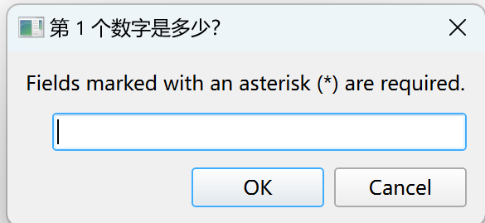
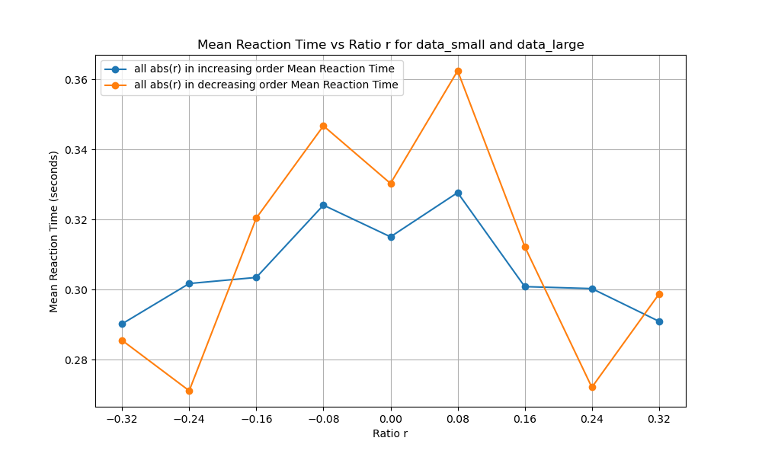
https://www.ypppt.com/
More Extensions
➡ Extension I - Memory
Continuously add numbers
Time turned out to be shorter, not longer!
Imagine a politic exam……
➡ Extension II - Sequential
| r | appear in ascending or descending order
Interesting differences
➡ ……

Slide 22
https://www.ypppt.com/
Deeper Insight
Understand the parameters
Accuracy
Response times (RTs)
The probabilities of making the two choices
Shortcomings of DDM
Post-hoc use and overfitting
Simplified assumptions
Sensitive to assumptions
……

Slide 23
https://www.ypppt.com/
Deeper Insight
Other Models about decision
Multi-Attribute Decision Making (MADM)
Decision Tree
Bayesian method
……
Inspirations for Our Life
Understand merits and demerits of human decision
Models are rigid, while humans are adaptable
How to make good decisions and view others’ decisions
……

Slide 24
01
Introduction
02
Basic DDM Experiment
CONTENT
03
Variants of DDM Experiment
04
Extensions of DDM and Deeper Insight
05
Conclusion

Slide 25
https://www.ypppt.com/
Conclusion
Not task-oriented but thinking-oriented
Simple but robust
Based on mathematical models but can inspire our life

Slide 26
https://www.ypppt.com/
References
[1]Ratcliff, R. (1978). A theory of memory retrieval. Psychological Review, 85(2), 59-108. https://doi.org/10.1037/0033-295X.85.2.59
[2]K. Britten, M. Shadlen, W. Newsome, and J. Movshon, “The analysis of visual motion: a comparison of neuronal and psychophysical performance,” Journal of Neuroscience, vol. 12, no. 12, pp. 4745–4765, 1992.
[3]R. Ratcliff and G. McKoon, “The Diffusion Decision Model: Theory and Data for Two-Choice Decision Tasks,” Neural Computation, vol. 20, pp. 873–922, Apr. 2008.

Slide 27
Thank You
Yong-Ming Tian, Zong-Yi Chen, Shiqi Liu, Yajie Li

